Slide 1


Digital Fitness Archiving
Amazon “Prime Bike”
Presented by: Evan Savaria
CS 895: Web Archiving Forensics
October 22, 2020

Slide 2
Outline
Introduction
Motivation
Web Archiving Analysis Tools
News
E-Commerce
Limitations
Timeline
Conclusion/Final Thoughts
Evan Savaria, 2020-10-22, Digital Fitness Archiving, Amazon Prime Bike
2

Slide 3
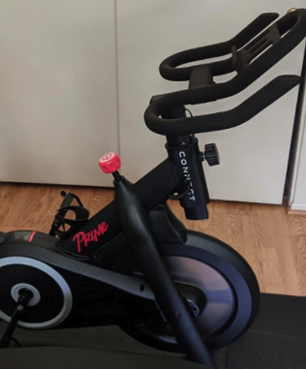
Introduction – Echelon
Echelon is an immersive, at-home connected cycling experience starting at $500.00
A direct competitor to Peloton, an industry leader in the new age of digital fitness that sells a premium bike starting at $1,895.00
Lou Lentine - CEO
Echelon officially announced the new Amazon Prime Bike, also known as Echelon Smart Connect Fitness Bike “EX-PRIME” on September 21, 2020
A couple days later September 23, 2020; Amazon denied partnering with Echelon on the bike and halted all sales on their site
https://cdn.geekwire.com/wp-content/uploads/2020/09/Screen-Shot-2020-09-22-at-9.41.42-AM.png
Evan Savaria, 2020-10-22, Digital Fitness Archiving, Amazon Prime Bike
3

Slide 4
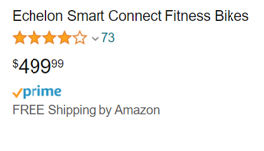
Motivation
Amazon disavows the $500 “Prime Bike,” saying it has no formal connection to the product.
The Echelon CEO announced the “EX-Prime Smart Connect Bike,” also known as the “Prime Bike” was developed in collaboration with Amazon. The CEO quotes:
"Amazon is looking to us to partner on their first-ever connected fitness product is recognition of our commitment to deliver quality at a reasonable price-point as reflected in our explosive growth over the last year.“
There are multiple news stories suggesting different views
I want to investigate the Echelon bike and if in fact they were truly advertising their bike as a “Amazon Prime Bike”.
https://www.amazon.com/Echelon-EX-PRIME-Smart-Connect-Fitness/dp/B088BBR84Z
Evan Savaria, 2020-10-22, Digital Fitness Archiving, Amazon Prime Bike
4

Slide 5









Web Archiving Analysis Tools
Evan Savaria, 2020-10-22, Digital Fitness Archiving, Amazon Prime Bike
5

Slide 6
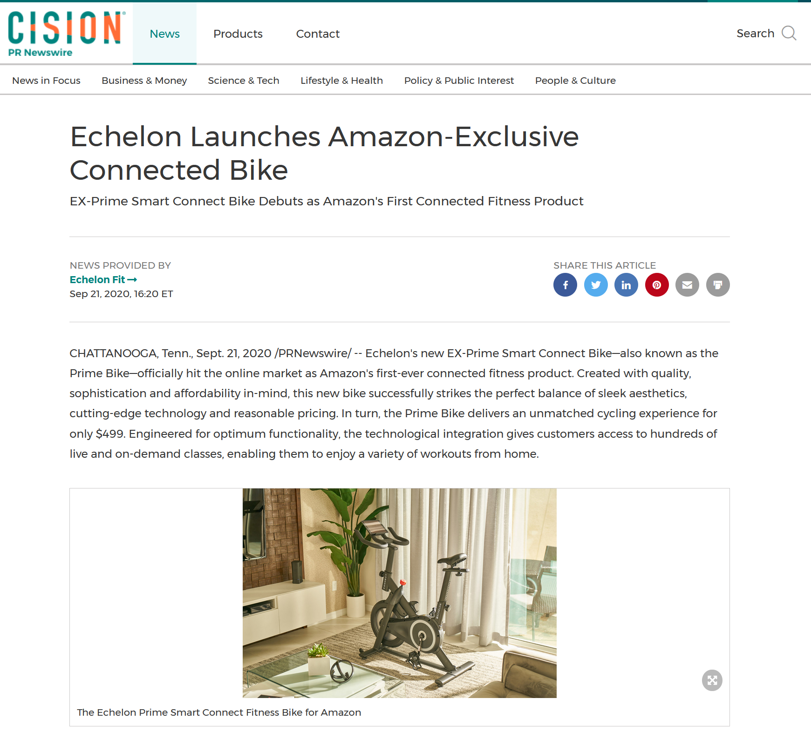
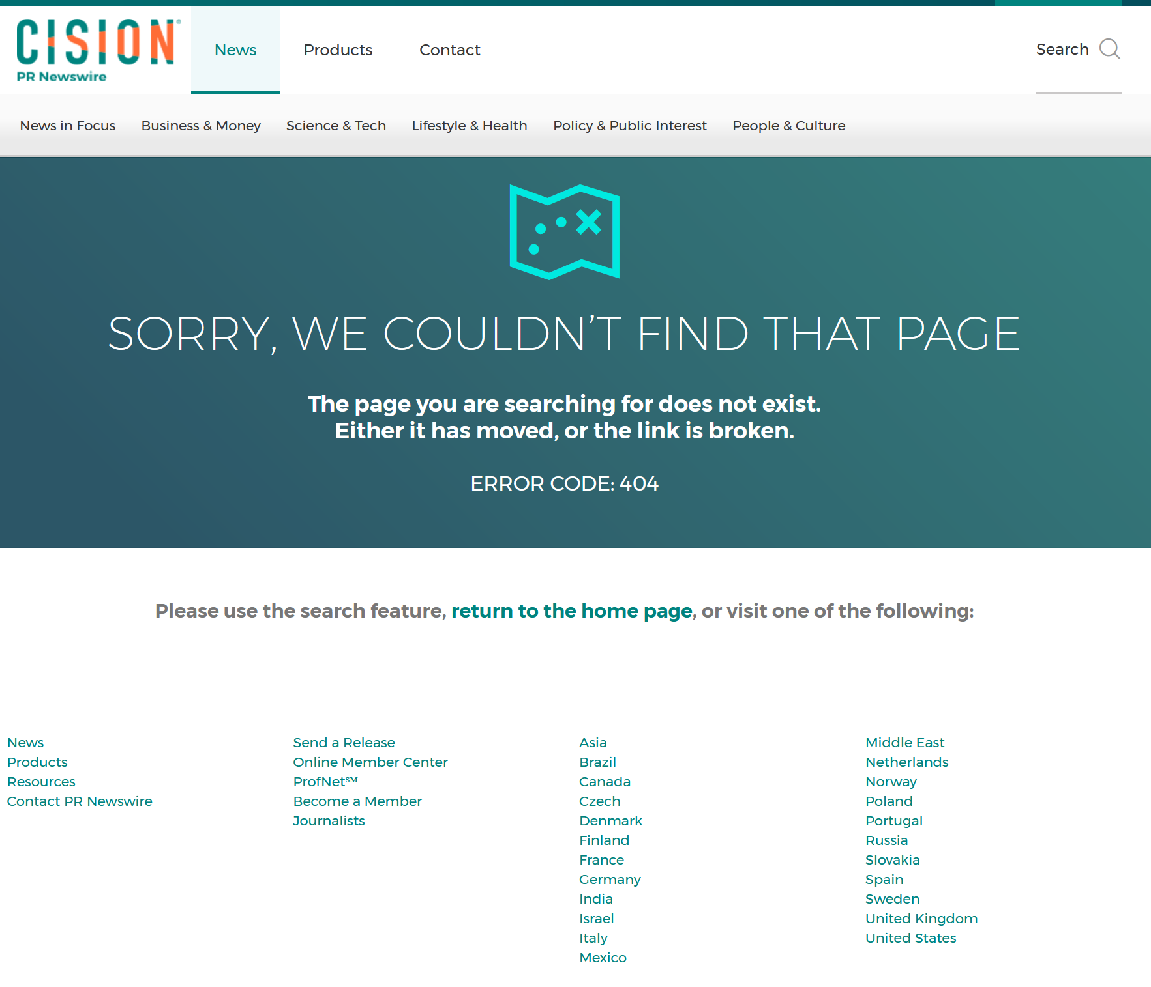
Press Release was removed following Amazon response
Provided Sept. 21, 16:20 ET
The link is now unreachable at Sept 23, 04:52
https://www.prnewswire.com/news-releases/echelon-launches-amazon-exclusive-connected-bike-301134962.html
- Archived Press Release
https://web.archive.org/web/20200923010459/https://www.prnewswire.com/news-releases/echelon-launches-amazon-exclusive-connected-bike-301134962.html
- Press Release Removed
https://www.prnewswire.com/news-releases/echelon-launches-amazon-exclusive-connected-bike-301134962.html
Evan Savaria, 2020-10-22, Digital Fitness Archiving, Amazon Prime Bike
6

Slide 7
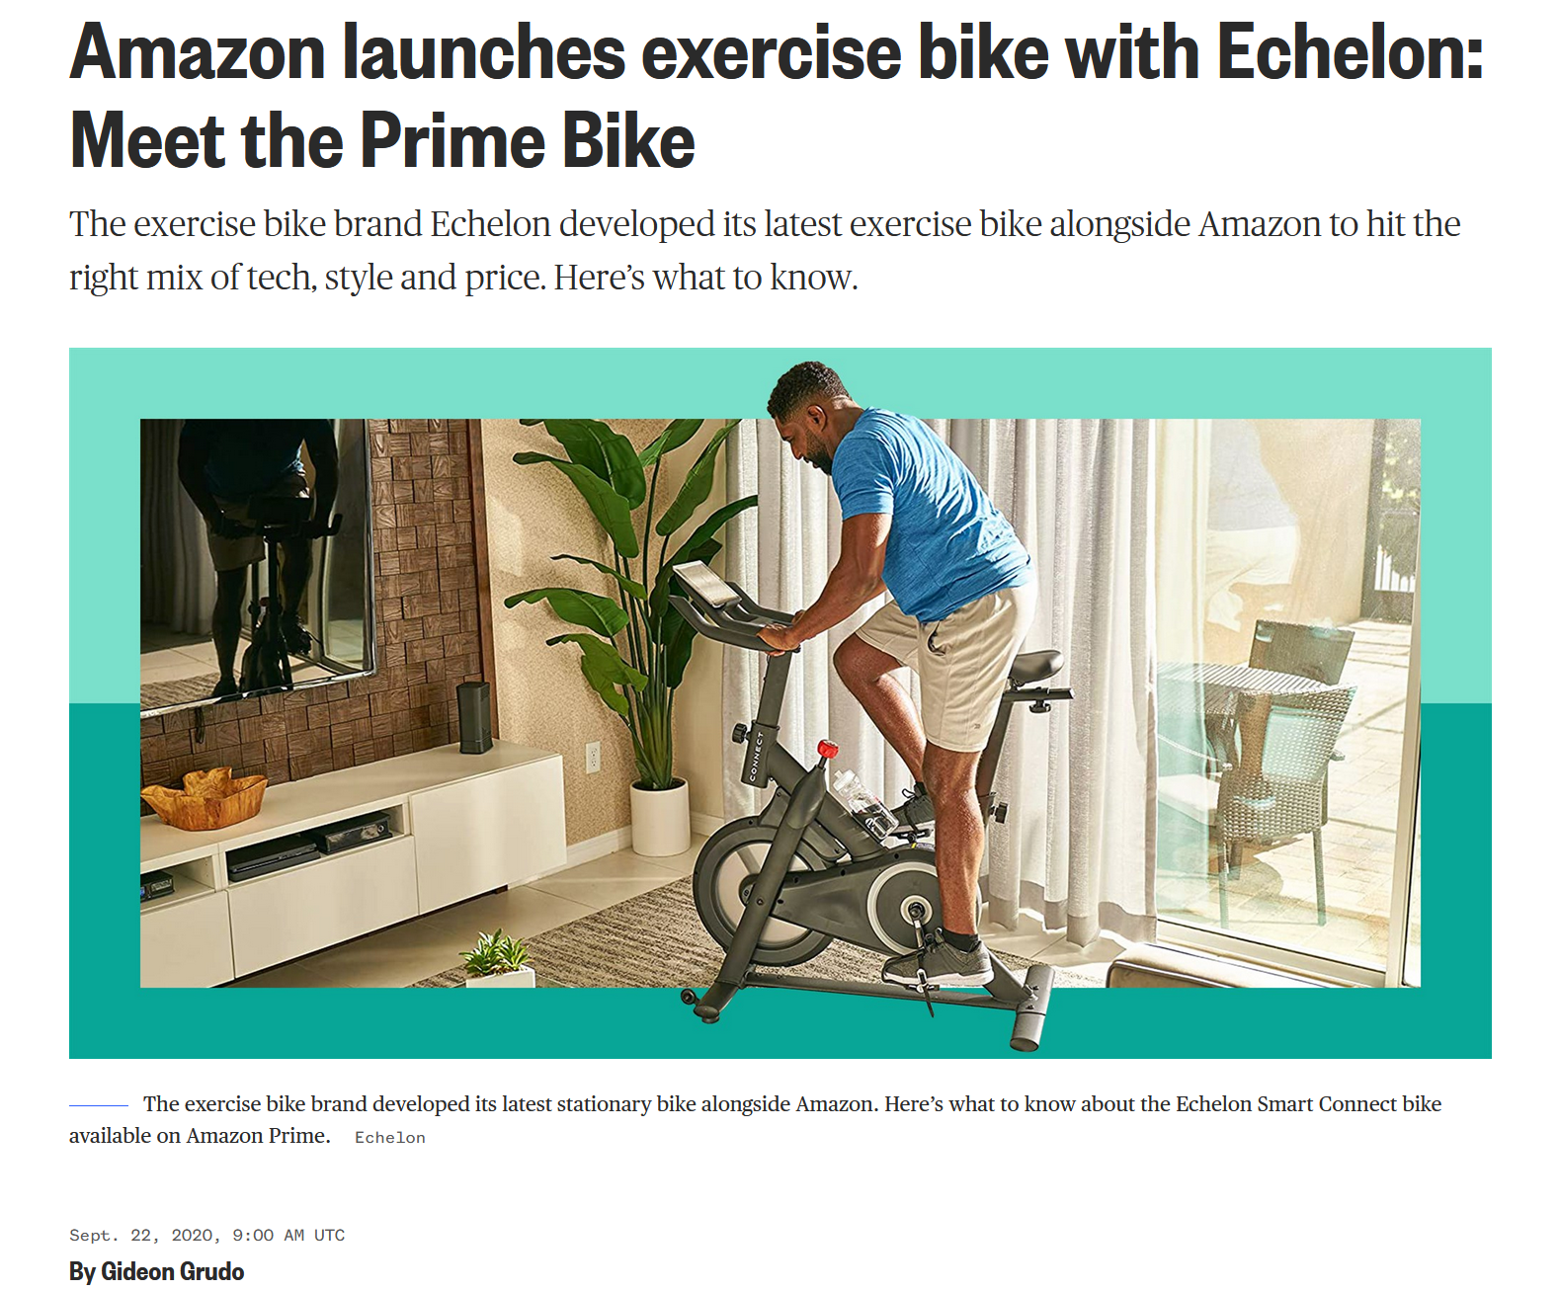
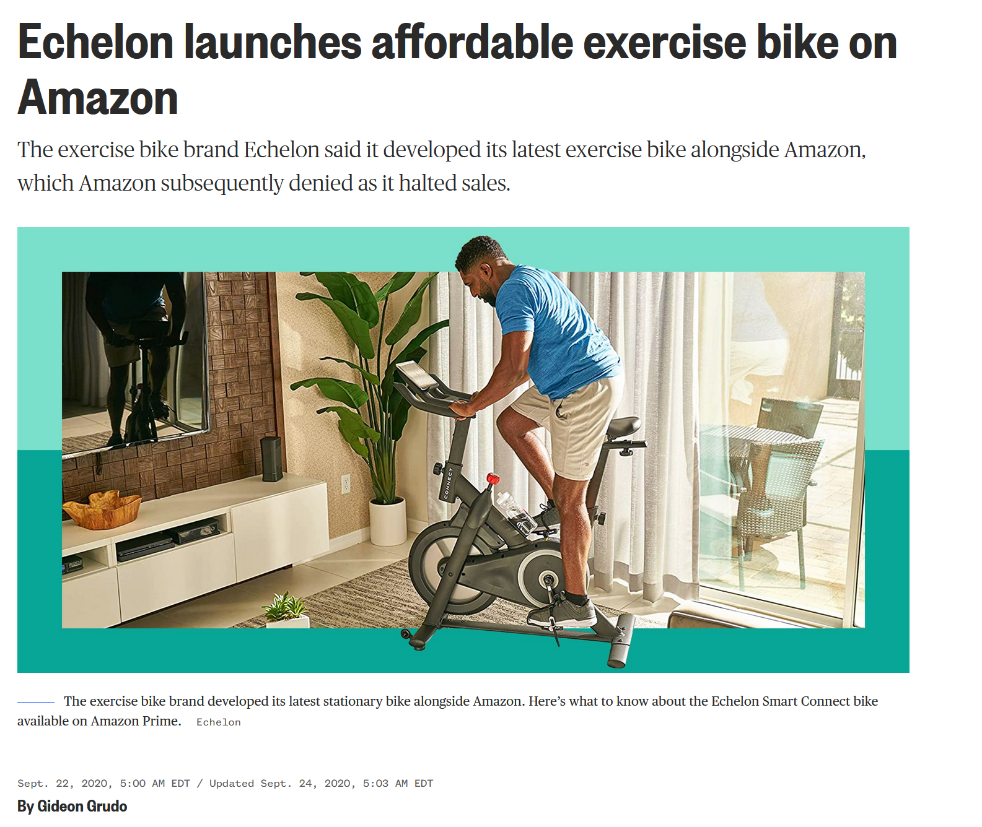
Article titles began to change once Amazon denied partnering with Echelon
Article titles began to change once Amazon denied partnering with Echelon
https://web.archive.org/web/20200922185859/https://www.nbcnews.com/shopping/fitness/amazon-prime-echelon-exercise-stationary-bike-n1240627
https://www.nbcnews.com/shopping/fitness/amazon-prime-echelon-exercise-stationary-bike-n1240627
Evan Savaria, 2020-10-22, Digital Fitness Archiving, Amazon Prime Bike
7

Slide 8
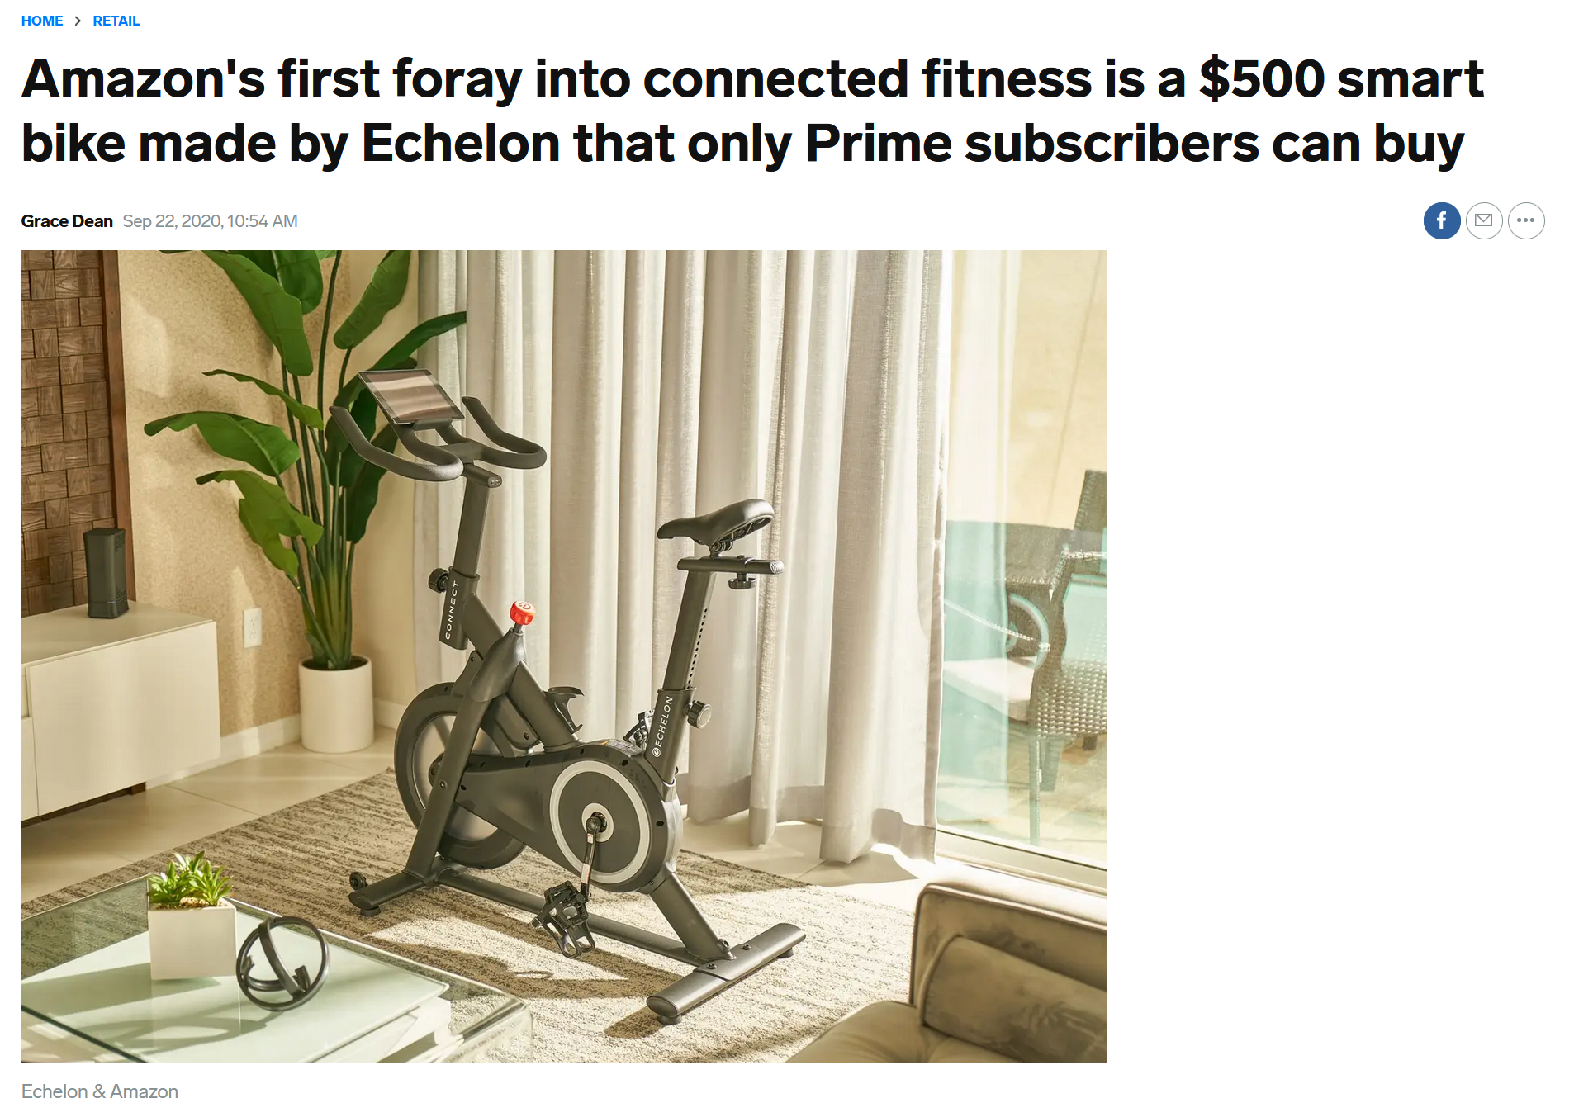
Business Insider stated Membership Required
The Busines Insider article on the right stated that you had to be an Amazon member to buy the new bike
This statement could suggest your $119 annual Amazon Prime membership has fitness benefits.
https://www.businessinsider.com/amazons-prime-bike-echelon-costs-prime-members-only-499-2020-9
Evan Savaria, 2020-10-22, Digital Fitness Archiving, Amazon Prime Bike
8

Slide 9

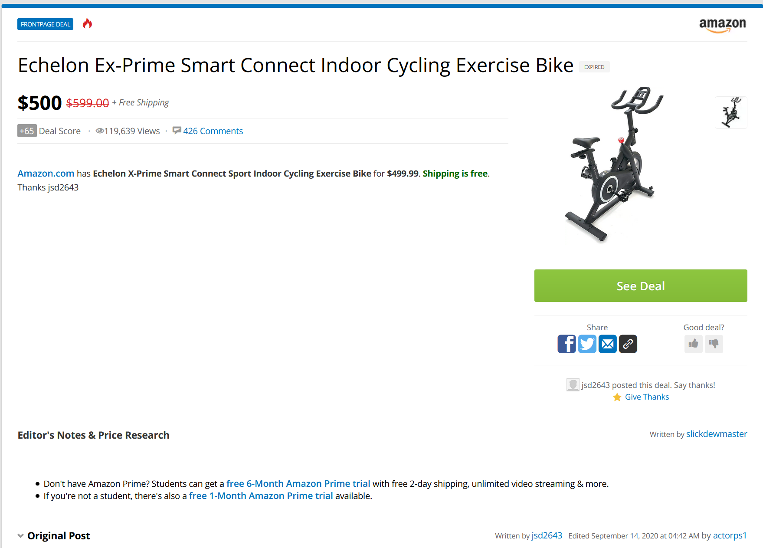
Slickdeals.net Frontpage Deal
https://slickdeals.net/f/14335583-echelon-smart-connect-fitness-bike-ex-prime-amazon-499-99
https://www.amazon.com/gp/product/B088BBR84Z/ref=ox_sc_act_title_1?tag=slicinc-20&ascsubtag=bd07a60e12eb11eb924c82142f90b8d80INT&smid=ATVPDKIKX0DER&psc=1
Evan Savaria, 2020-10-22, Digital Fitness Archiving, Amazon Prime Bike
9

Slide 10
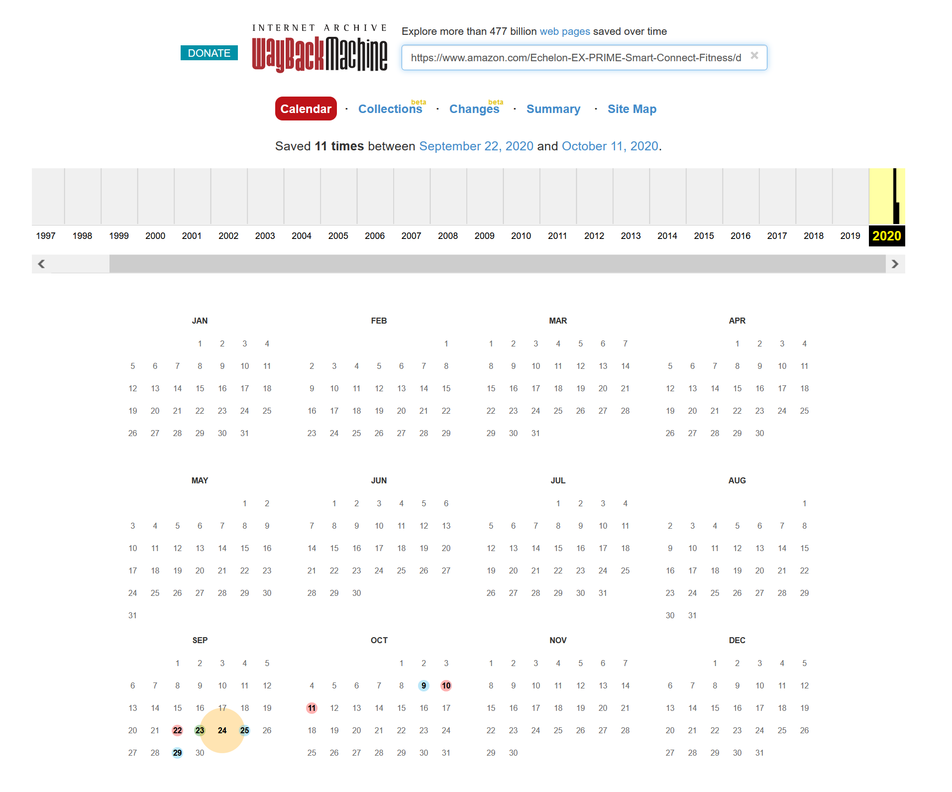
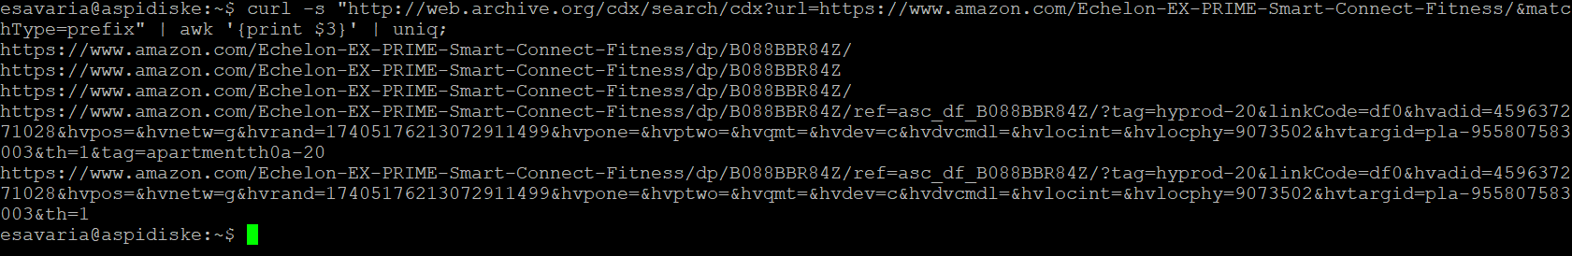
Echelon Prime Bike Link
The Live Echelon Prime Bike link is no longer available
https://www.amazon.com/Echelon-EX-PRIME-Smart-Connect-Fitness
Looking through the archives we still get a server error (5xx) on September 22nd on the day the news was released
curl -s "http://web.archive.org/cdx/search/cdx?url=https://www.amazon.com/Echelon-EX-PRIME-Smart-Connect-Fitness/&matchType=prefix" | awk '{print $3}' | uniq;
https://web.archive.org/web/*/https://www.amazon.com/Echelon-EX-PRIME-Smart-Connect-Fitness/dp/B088BBR84Z/
Evan Savaria, 2020-10-22, Digital Fitness Archiving, Amazon Prime Bike
10

Slide 11
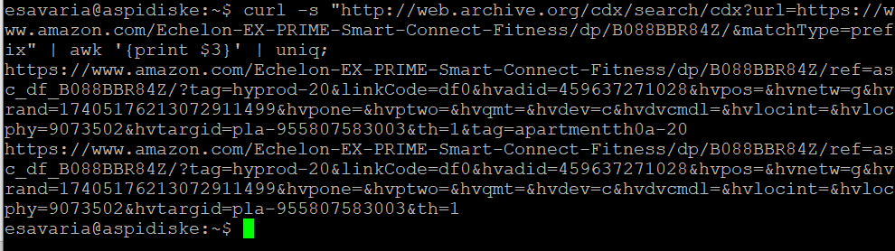
Limitations in the Archives
https://www.amazon.com/gp/product/B088BBR84Z
https://www.amazon.com/Echelon-EX-PRIME-Smart- Connect- Fitness/dp/B088BBR84Z
Amazon is not well archived and there are many versions of the URI for the same product
Amazon is very good at removing all traces of data for a product
The bike was only socially referred to as a “Prime Bike” for slightly over a day and web crawlers did not have enough time to archive the data
News sites quickly changed their postings, making the creation of a timeline difficult
curl -s "http://web.archive.org/cdx/search/cdx?url=https://www.amazon.com/gp/product/B088BBR84Z&matchType=prefix" | awk '{print $3}' | uniq;
curl -s "http://web.archive.org/cdx/search/cdx?url=https://www.amazon.com/Echelon-EX-PRIME-Smart-Connect-Fitness/dp/B088BBR84Z/&matchType=prefix" | awk '{print $3}' | uniq;
Evan Savaria, 2020-10-22, Digital Fitness Archiving, Amazon Prime Bike
11

Slide 12

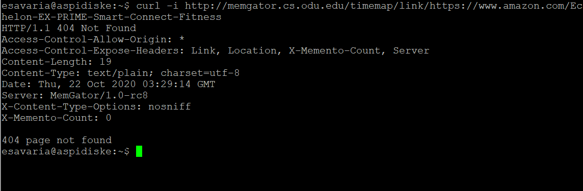
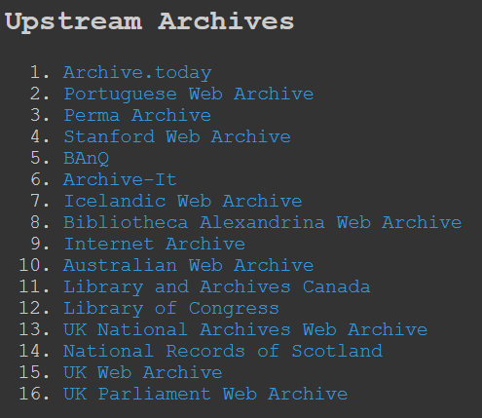
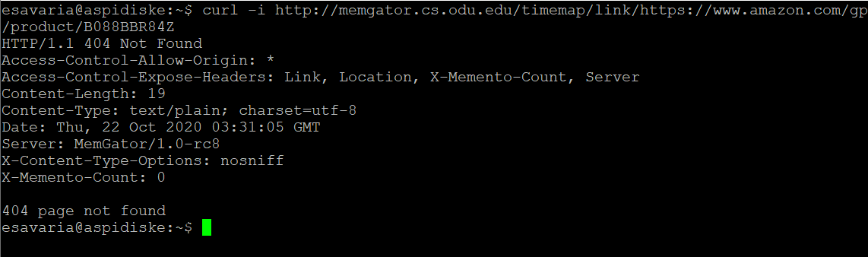
MemGator Curl –i Search
curl -i "http://memgator.cs.odu.edu/timemap/link/https://www.amazon.com/Echelon-EX-PRIME-Smart-Connect-Fitness"
No Results from (16) preferred archive list
curl -i "http://memgator.cs.odu.edu/timemap/link/https://www.amazon.com/gp/product/
B088BBR84Z"
Evan Savaria, 2020-10-22, Digital Fitness Archiving, Amazon Prime Bike
12

Slide 13
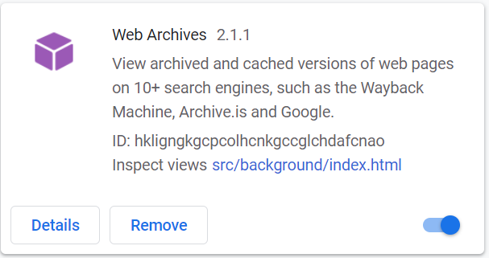
Web Archives V2.1.1 Chrome Extension for Web Archiving
Includes: Wayback Machine, Google Cache, Bing Cache, Yandex, Archive.is, memento Time Travel, WebCite, Exalead Cache, Gigablast Cache, Soguo Snapshot, Qihoo 360 Search Snapshot, Baidu Snapshot, Naver Cache, Yahoo Japan Cache, and Megalodon
Yandex returned (1) result for the URI:
https://www.amazon.com/Echelon-EX-PRIME-Smart-Connect-Fitness/dp/B088BBR84Z
https://chrome.google.com/webstore/detail/web-archives/hkligngkgcpcolhcnkgccglchdafcnao?hl=en
Evan Savaria, 2020-10-22, Digital Fitness Archiving, Amazon Prime Bike
13

Slide 14

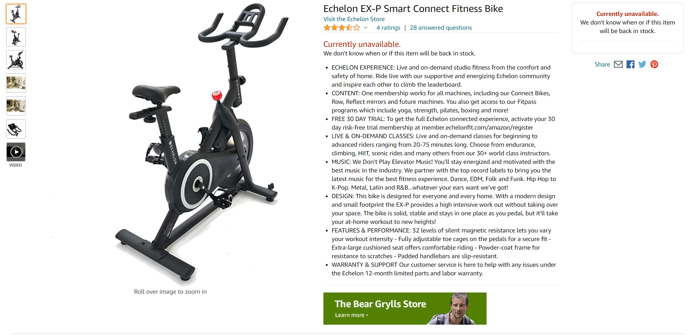
Yandex Cached Prime Bike Page
23 September 2020 07:14:11 GMT
Yandex- a Russian Internet services Corporation
Yandex Cache- a web crawler which saves a snapshot of websites
Archive.is Link:
https://archive.vn/ALbGa
https://yandexwebcache.net/yandbtm?lang=en&fmode=inject&tm=1603202440&tld=com&la=1600845312&text=https%3A%2F%2Fwww.amazon.com%2FEchelon-EX-PRIME-Smart-Connect-Fitness%2Fdp%2FB088BBR84Z%2F&url=https%3A%2F%2Fwww.amazon.com%2FEchelon-EX-PRIME-Smart-Connect-Fitness%2Fdp%2FB088BBR84Z&l10n=en&mime=html&sign=5b930a68bcada172fff436d9bd21cce7&keyno=0
Evan Savaria, 2020-10-22, Digital Fitness Archiving, Amazon Prime Bike
14

Slide 15
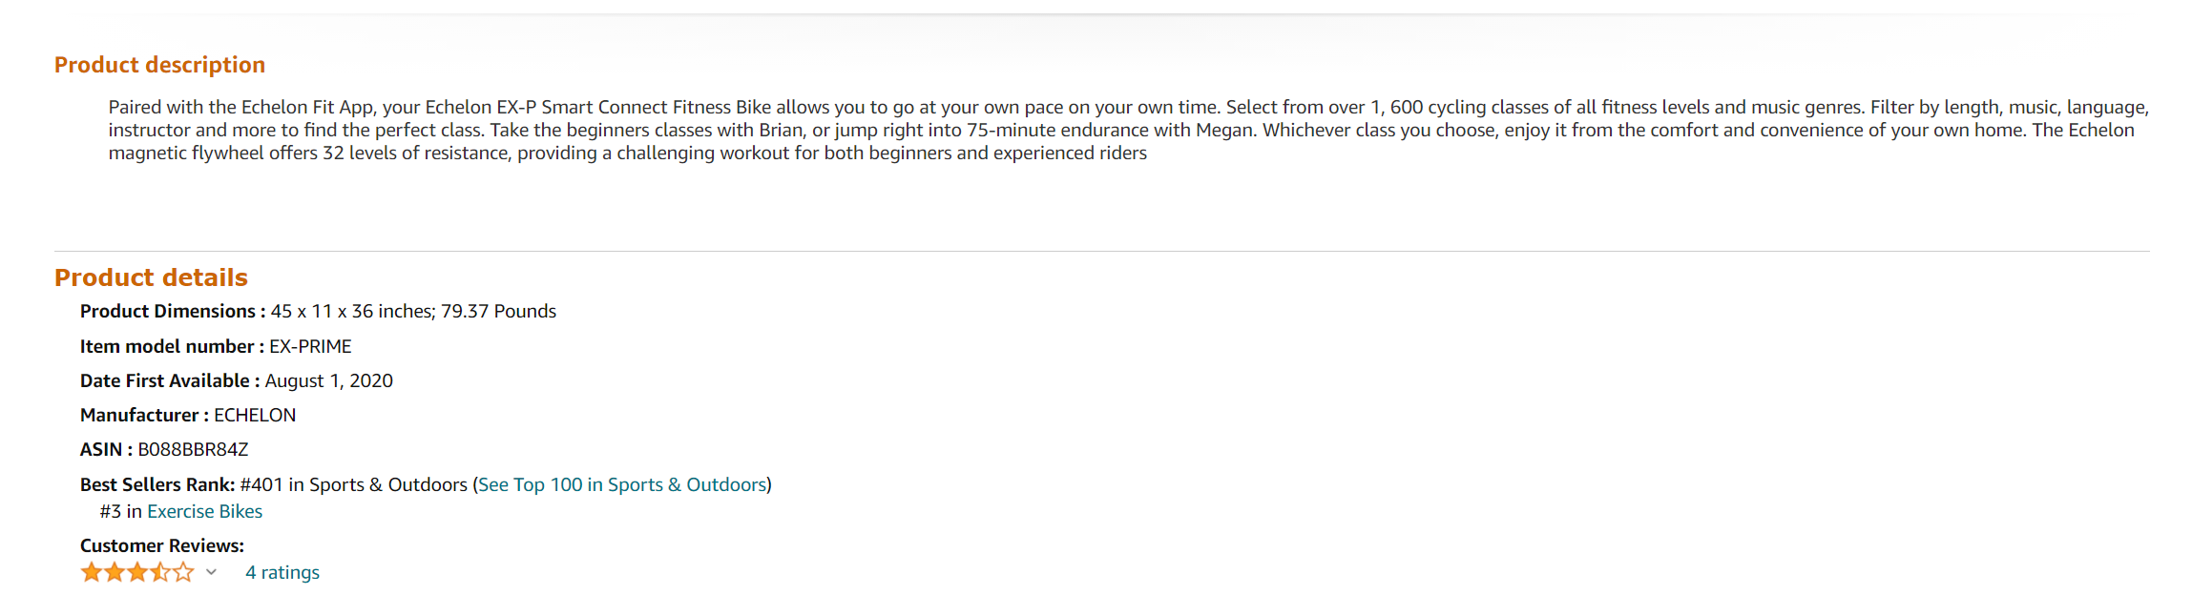
Prime Bike Description
https://yandexwebcache.net/yandbtm?lang=en&fmode=inject&tm=1603202440&tld=com&la=1600845312&text=https%3A%2F%2Fwww.amazon.com%2FEchelon-EX-PRIME-Smart-Connect-Fitness%2Fdp%2FB088BBR84Z%2F&url=https%3A%2F%2Fwww.amazon.com%2FEchelon-EX-PRIME-Smart-Connect-Fitness%2Fdp%2FB088BBR84Z&l10n=en&mime=html&sign=5b930a68bcada172fff436d9bd21cce7&keyno=0
Evan Savaria, 2020-10-22, Digital Fitness Archiving, Amazon Prime Bike
15

Slide 16
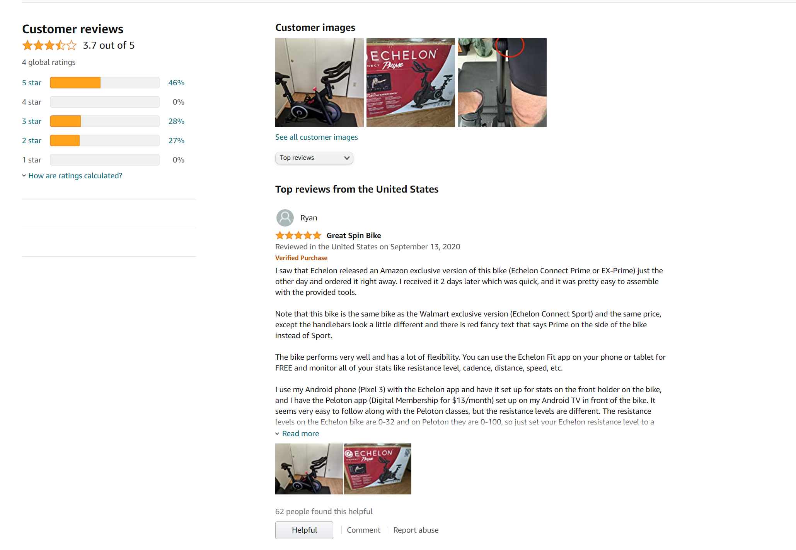
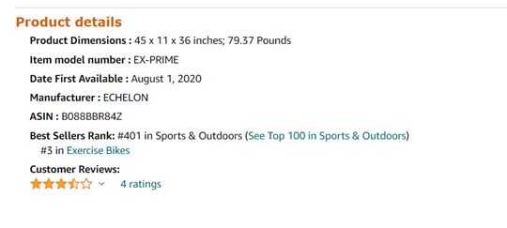
Prime Bike Amazon Reviews
Proof of the bike style and proof of the release date of the bike of August 1, 2020.
https://yandexwebcache.net/yandbtm?lang=en&fmode=inject&tm=1603202440&tld=com&la=1600845312&text=https%3A%2F%2Fwww.amazon.com%2FEchelon-EX-PRIME-Smart-Connect-Fitness%2Fdp%2FB088BBR84Z%2F&url=https%3A%2F%2Fwww.amazon.com%2FEchelon-EX-PRIME-Smart-Connect-Fitness%2Fdp%2FB088BBR84Z&l10n=en&mime=html&sign=5b930a68bcada172fff436d9bd21cce7&keyno=0
Evan Savaria, 2020-10-22, Digital Fitness Archiving, Amazon Prime Bike
16

Slide 17
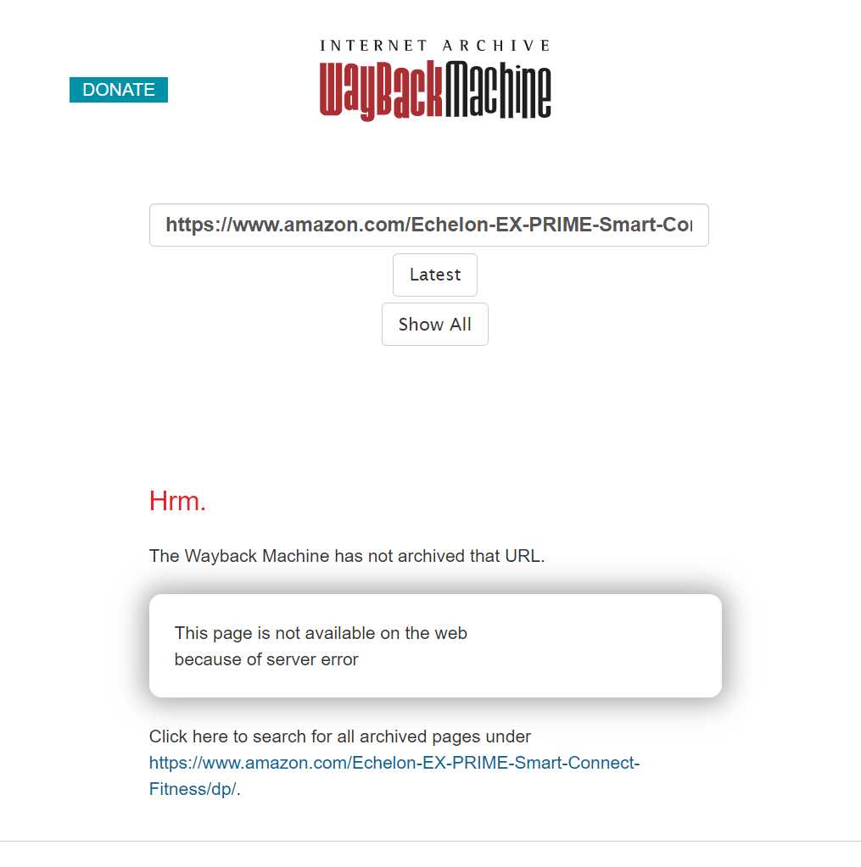
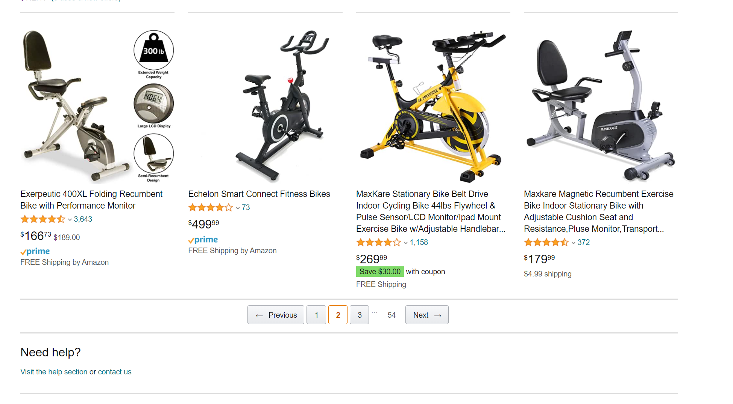
Wayback Machine Results
September 20, 2020
http://web.archive.org/web/20200920145452/https://www.amazon.com/Echelon-EX-PRIME-Smart-Connect-Fitness/dp/B088BBR84Z?dchild=1
http://web.archive.org/web/20200920145452if_/https://www.amazon.com/Exercise-Bikes-Cardio-Training/s?rh=n%3A3407781&page=2
Evan Savaria, 2020-10-22, Digital Fitness Archiving, Amazon Prime Bike
17

Slide 18
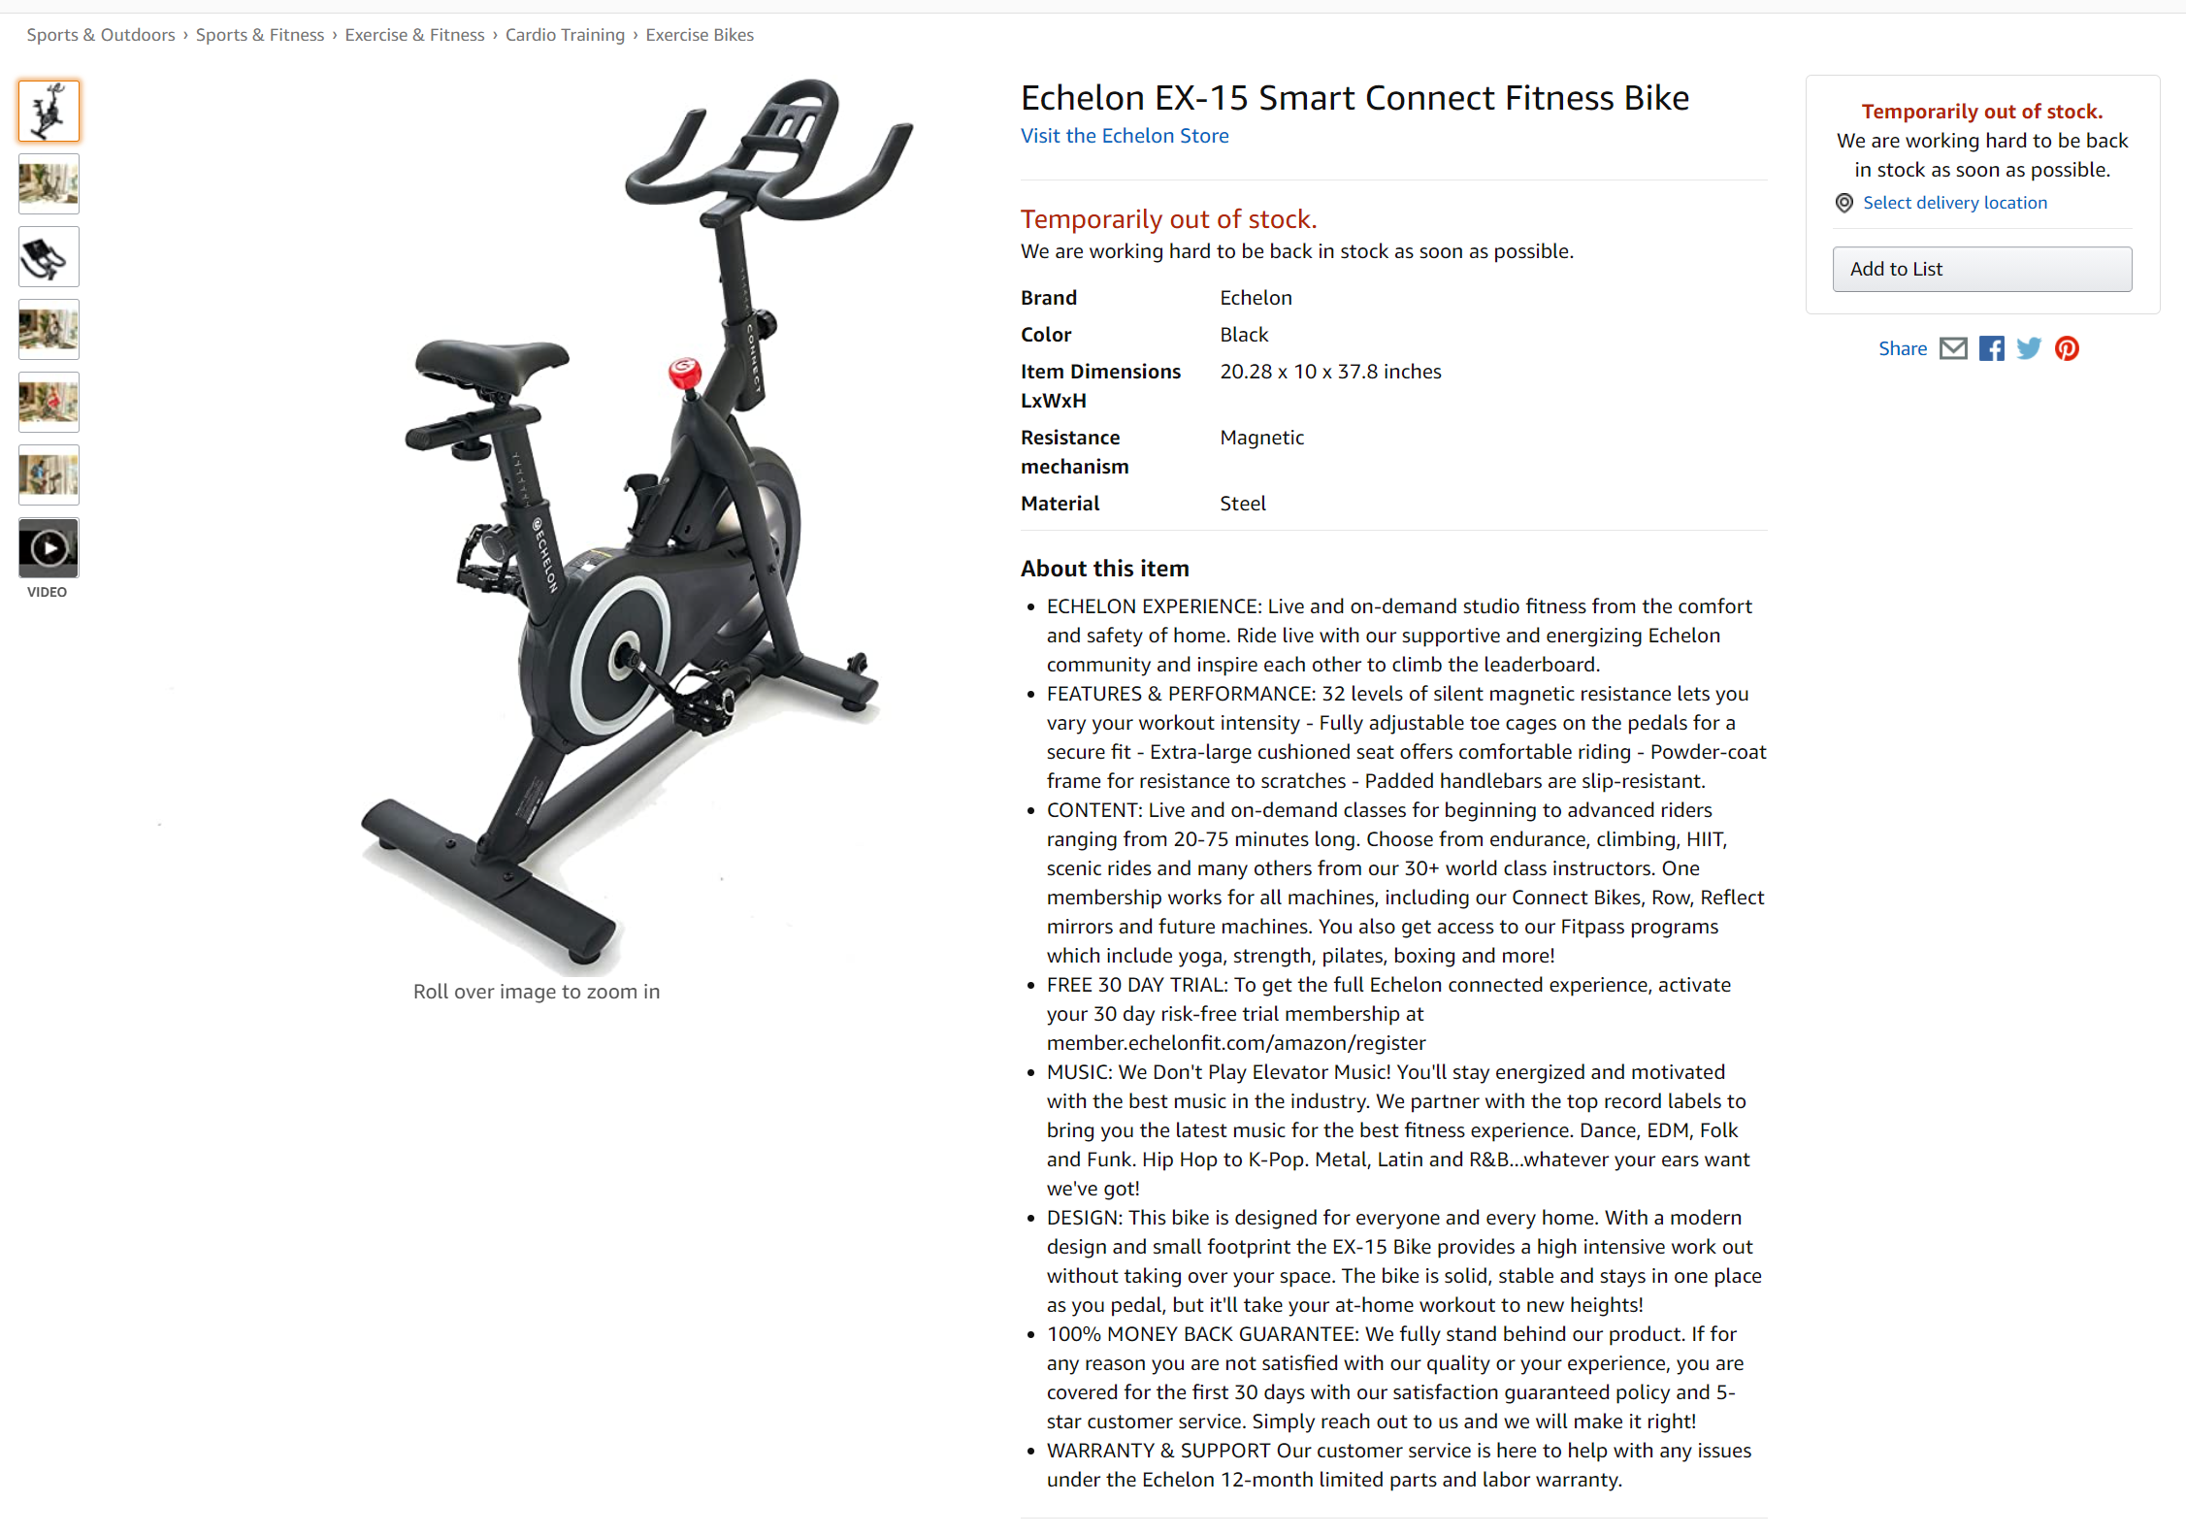
Latest Amazon Link
Internet Archive Link:
https://web.archive.org/web/20201022035654/https://www.amazon.com/dp/B08K4GS4KN/ref=as_li_ss_tl?ie=UTF8&linkCode=sl1&tag=pinterest723-20&linkId=0420ae681e7e894a7c14386e2964bb41&language=en_US
Archive.is Link:
https://archive.is/cUNLH
https://www.amazon.com/dp/B08K4GS4KN/ref=as_li_ss_tl?ie=UTF8&linkCode=sl1&tag=pinterest723-20&linkId=0420ae681e7e894a7c14386e2964bb41&language=en_US
Evan Savaria, 2020-10-22, Digital Fitness Archiving, Amazon Prime Bike
18

Slide 19
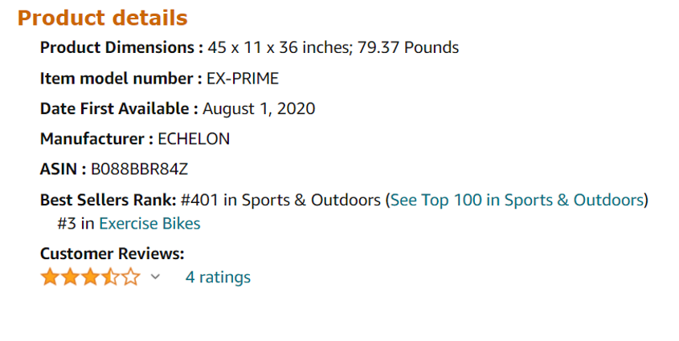
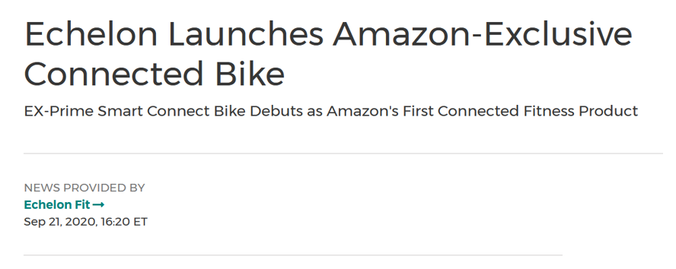
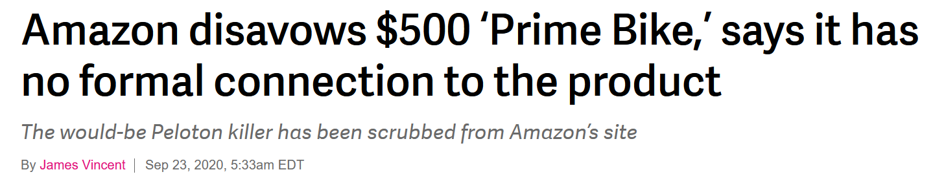
Timeline of Events
Prime Bike Silent Release
Prime Bike Official Release
Amazon Denies
Partnership
August 01, 2020
September 21, 2020
September 23, 2020
Prime Bike is removed from site
Evan Savaria, 2020-10-22, Digital Fitness Archiving, Amazon Prime Bike
19

Slide 20
Conclusions/Final thoughts
It was surprising how Amazon was not archived well
The Yandex search engine, out of (16) other tools, was the only archived page that was recovered
Amazon had the “Prime Bike” listed on the Internet for approximately (54) days
Amazon does not ship to Russia, which raises suspicion why the link was cached on their search engine
News articles quickly changed their viewpoints from “Amazon-focused” to “Echelon-focused”
The Prime bike was available for over a month on Amazon. It seems there is more to this story than miscommunication like the Echelon CEO suggests:
"It's an exclusive bike for them, we're excited about it. We're coming out with a new name for the bike. It was a misunderstanding in their internal teams.“ – Lou Lentine (Echelon CEO)
https://finance.yahoo.com/news/amazon-denies-working-echelon-prime-110717064.html
Evan Savaria, 2020-10-22, Digital Fitness Archiving, Amazon Prime Bike
20

